Slide 1
Explanation on :
1)Height of a binary tree
2)Smallest number with atleast n trailing zeros in a factorial
By:Syeda Nimra
RVCE24MCA008

Slide 2
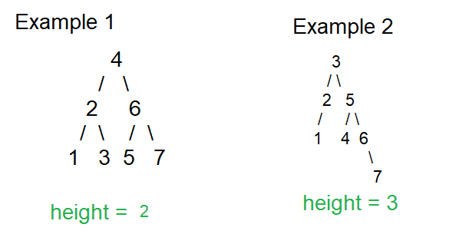
Finding Height of a binary tree
The length of the longest path from the root of a binary tree to a leaf node is the height of the binary tree.
The height of the root is the height of the tree.
Height of a node K (of a Binary Tree) = Number of edges in the longest path connecting K to any leaf node.

Slide 3
Code to find height of binary tree
#include <stdio.h>
#include <stdlib.h>
struct Node { //Structure of a Binary Tree Node
int data;
struct Node* left;
struct Node* right;
};
struct Node* newNode(int data) { // Function to create a new node
struct Node* node = (struct Node*)malloc(sizeof(struct Node));
node->data = data;
node->left = NULL;
node->right = NULL;
return node;
}

Slide 4
int heightOfTree(struct Node* root) { // Function to find the height of the binary tree
if (root == NULL)
return -1;
int leftHeight = heightOfTree(root->left); // Height of left subtree
int rightHeight = heightOfTree(root->right); // Height of right subtree
return (leftHeight > rightHeight ? leftHeight : rightHeight) + 1;
}
int main() { // Driver Code
struct Node* root = newNode(10); // Binary Tree Formation
root->left = newNode(20);
root->right = newNode(30);
root->left->left = newNode(40);
root->left->right = newNode(28);
root->right->left = newNode(27);
root->right->right = newNode(50);
root->right->left->right = newNode(29);
printf("Height of given binary tree is %d\n", heightOfTree(root));
return 0;
}

Slide 5
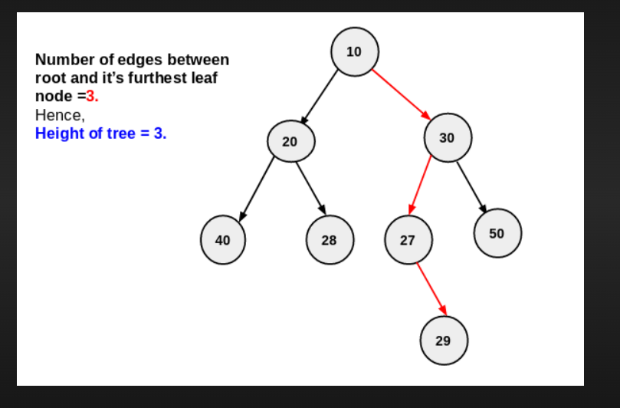
OUTPUT:
Height of given binary tree is 3

Slide 6
Smallest number with atleast n trailing zeros in a factorial
Given a number n. The task is to find the smallest number whose factorial contains at least n trailing zeroes.
Input : n = 1 //We need to find the smallest number whose factorial has at least 1 trailing zeroes.
Output : 5
1!, 2!, 3!, 4! does not contain trailing zero.
5! = 120, which contains one trailing zero.

Slide 7
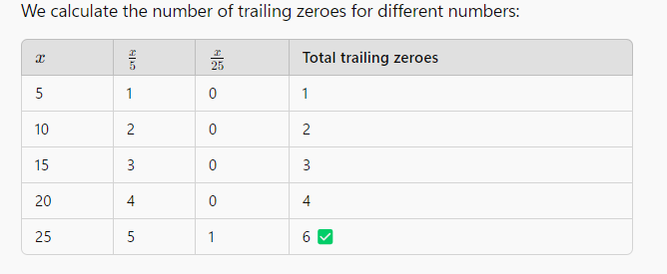
Smallest number with atleast n trailing zeros in a factorial
Input : n = 6 //We need to find the smallest number whose factorial has at least 6 trailing zeroes.
Output : 25.

Slide 8
Code:
#include <stdio.h>
int check(int p, int n) { // Function to check if p! contains at least n trailing zeroes
int temp = p, count = 0, f = 5;
while (f <= temp) {
count += temp / f; // Count factors of 5, 25, 125, etc.
f *= 5;
}
return (count >= n); // Return true if at least n trailing zeroes are found
}
int findNum(int n) { // Function to find the smallest number whose factorial has at least n trailing zeroes
if (n == 1)
return 5; // 5! = 120, which has 1 trailing zero
int low = 0, high = 5 * n; // Define search range

Slide 9
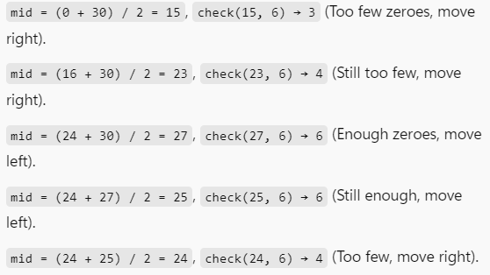
Code:
while (low < high) {
int mid = (low + high) / 2; // Find mid-point for binary search
if (check(mid, n))
high = mid; // If mid! has enough zeroes, search left half
else
low = mid + 1; // Otherwise, search right half
}
return low; // Smallest number whose factorial has at least n trailing zeroes
}
int main() {
int n = 6;
printf("Smallest number with at least %d trailing zeroes in factorial: %d\n", n, findNum(n));
return 0;
}
OUTPUT
Smallest number with at least %d trailing zeroes in factorial:25

